Slide 1
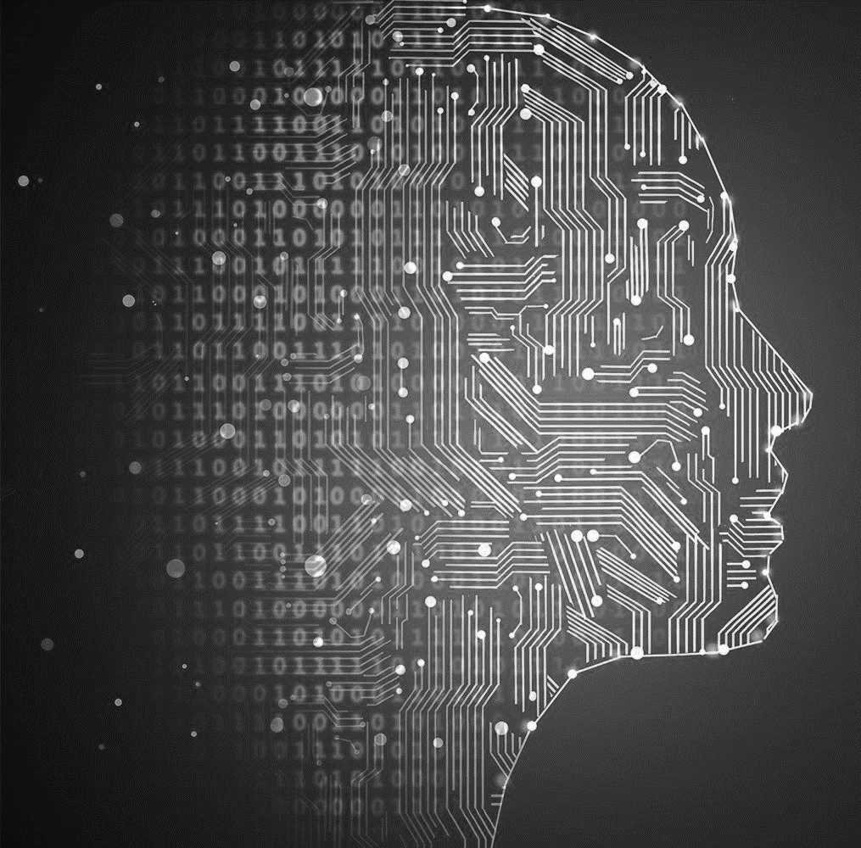

Transformers
Advanced Deep Learning Techniques,
Dr. Eyal Kolman

Slide 2
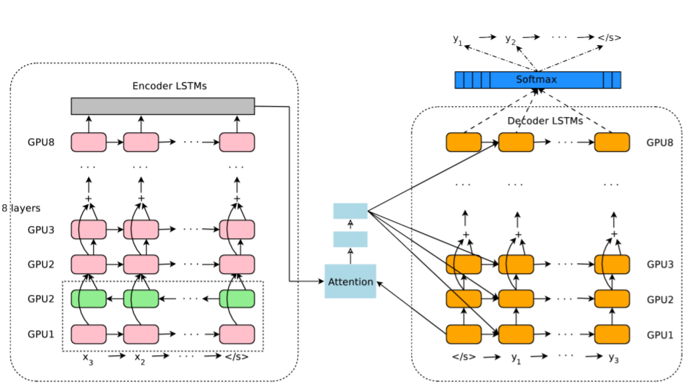
Pre-Transformers Models
Neural Networks progression steps:
Feed-Forward
RNNs (Recurrent Neural Networks)
GRUs/LSTMs
Bi-directional LSTMs
BiLSTMs with Attention
Flow is sequential; problematic for long sequences
Google’s NMT system (2016)

Slide 3
Google’s NMT system (2016)

Slide 4
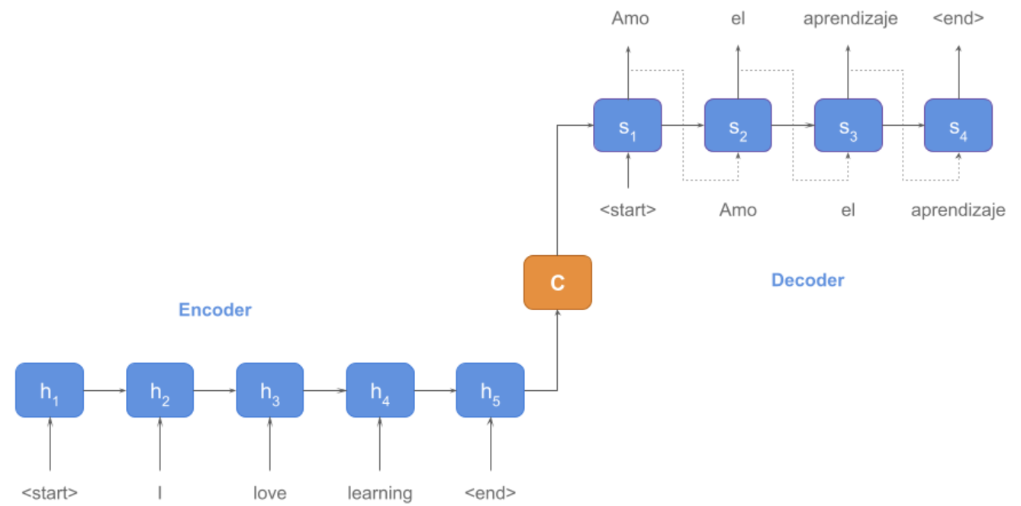
Sequence to Sequence models

Slide 5
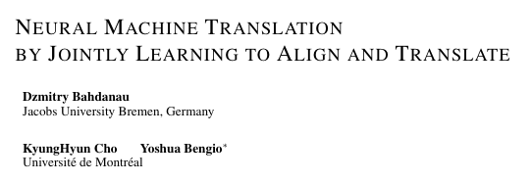
Attention (2015): Direct Access to “words”
37k citations

Slide 6

Attention Mechanism
Three elements: q: Query; k: Key; v: Value
Query and Key generate a similarity score
$Score\left(q{,k}_{i}\right)=q^{T}∙k_{i}$
The scores are used to weight the Values
$w=Softmax\left(Score\left(q,k\right)\right)$→${ w}_{i}=\frac{exp\left(q^{T}∙k_{i}\right)}{\sum_{j}{exp\left(q^{T}∙k_{j}\right)}}$
$V_{Attention}=\sum{w_{i}v_{i}}$
Can we use only the attention, without the sequential flow?

Slide 7
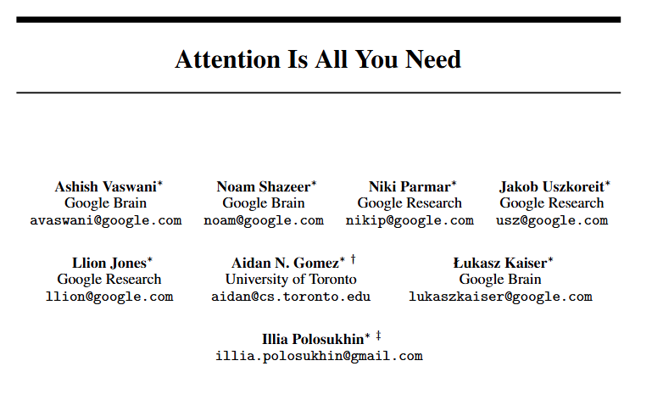
Attention is All You Need, 2017 (69k 125k 142k citations)

Slide 8
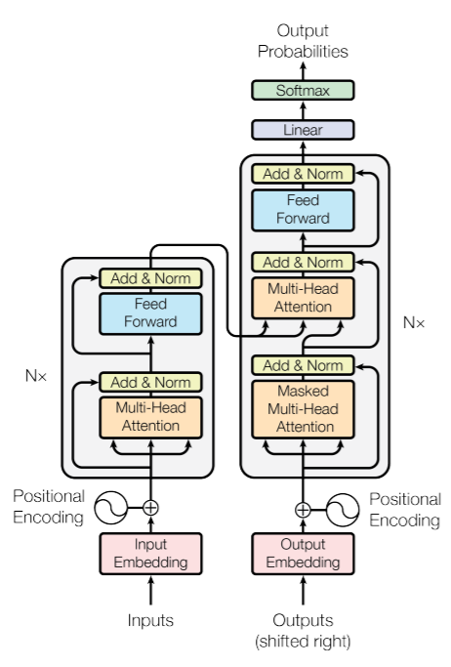
Attention is All You Need, 2017 (69k 125k 142k citations)
No need for sequential process, only attention
Computation is parallel
Training is much faster
More data can be used for training
Inference and train time does not depend on number of words, only on number of layers
Today, EVERYTHING is Transformers!

Slide 9
Architecture
Decoder
Encoder-Decoder structure
Encoder has 6 layers
Each layer:
Multi-head self-attention
Sum with input + Normalization
FF network
Sum with input + Normalization
Encoder

Slide 10
Architecture
Encoder-Decoder structure
Decoder has 6 layers
Each layer:
Masked Multi-head Attention
Sum with input + Normalization
Multi-head self-attention
Sum with input + Normalization
FF network
Sum with input + Normalization

Slide 11
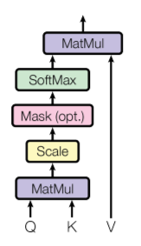
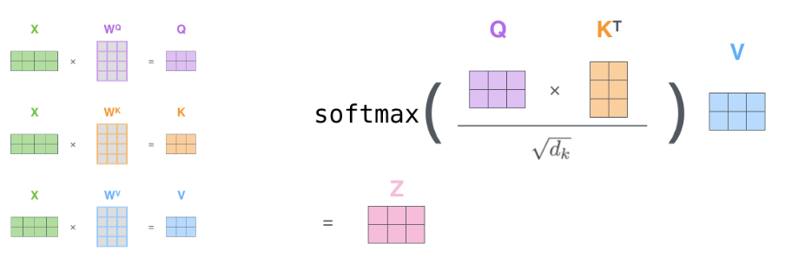

Self-attention
Scaled dot-product
Input is converted to three different inputs:
$Query:Q={v_{input}∙W}^{q}$
$Key:K={v_{input}∙W}^{k}$
$Value:V={v_{input}∙W}^{v}$
$Attention\left(Q,K,V\right)=SoftMax\left(\frac{QK^{T}}{\sqrt{d_{k}}}\right)∙V$
$A_{i}=\left(q_{i}k_{1}^{T}\right)∙v_{1}+\left(q_{i}k_{2}^{T}\right)∙v_{2}+⋯+\left(q_{i}k_{N}^{T}\right)∙v_{N}$
The weight of $v_{j}$ in the attention i is $q_{i}k_{j}^{T}$
Query and Key define the score
SoftMax normalizes the weights
Value is weighted by the normalized score

Slide 12

Self-attention
$Attention\left(Q,K,V\right)=SoftMax\left(\frac{QK^{T}}{\sqrt{d_{k}}}\right)∙V$
Scaling:
Performance deteriorates with larger $d_{k}$’s
Probably due to high values that brings Softmax to saturation
Example: If Q and K elements ~N(0,1), then their multiplication has a zero average and $d_{k}$ variance. Hence, the normalization

Slide 13
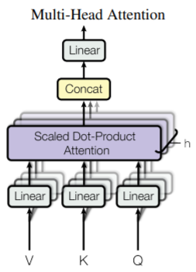
Multi-head Attention
Instead of one self-attention, h attentions are implemented in parallel:
Dimensionality reduction d →d/h, and different inputs for each head
h attention heads are applied
h outputs are concatenated: d/h → d
Another linear transformation is applied to the concatenated output
h=8, and the inner dimensions are 512/8 = 64
Each attention head is supposed to focus on a different aspect

Slide 14
Three Multi-head Attentions
MHA is applied three times:
Encoder self-attention:
Q, K, V come from the previous layer
Encoder-Decoder attention:
Q from the previous layer
K, V from the Encoder (this is similar to the classic attention implementation)
Decoder self-attention:
Q, K, V come from the previous layer
‘Future’ tokens are masked to avoid illegal inputs (words depend only on previous words)

Slide 15
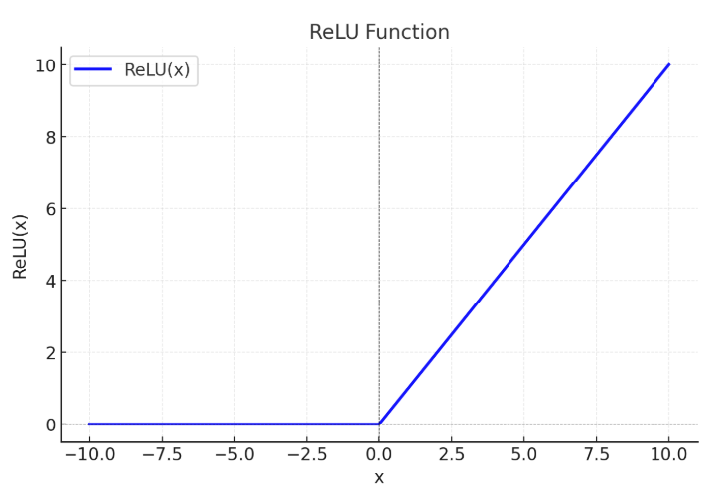
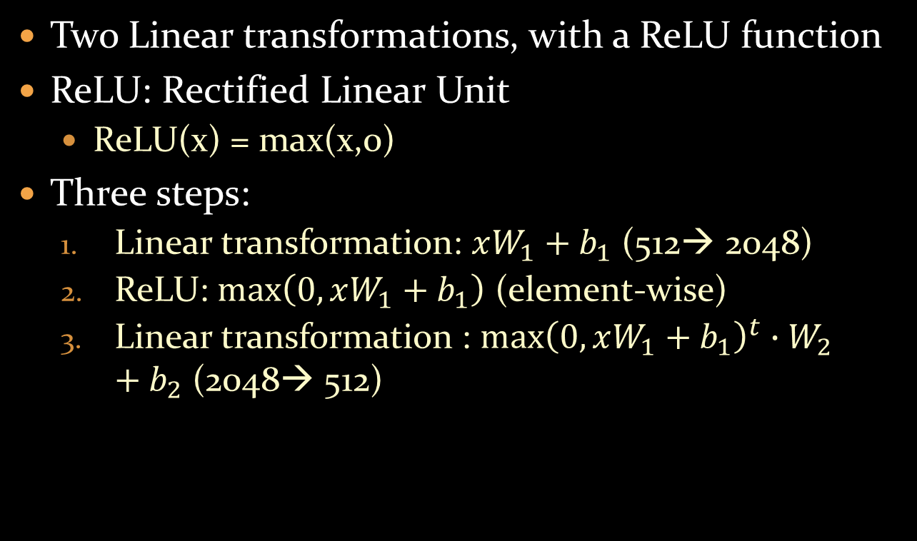
Feed-Forward Networks
Two Linear transformations, with a ReLU function
ReLU: Rectified Linear Unit
ReLU(x) = max(x,0)
Three steps:
Linear transformation: $xW_{1}+b_{1}$ (512→ 2048)
ReLU: $max\left(0,xW_{1}+b_{1}\right)$ (element-wise)
Linear transformation : ${max\left(0,xW_{1}+b_{1}\right)}^{t}∙W_{2}+b_{2}$ (2048→ 512)

Slide 16

Layer Normalization
The FF output is added to the input
The input directly transforms to the output
Called ‘skip links’
Normalization = Standardization : ${\hat{x}}_{i}=\frac{x_{i}−μ}{σ}$
Mean $μ$ and standard deviation $σ$are extracted over the entire vector (unlike batch-normalization where the normalization is over the same feature, cross batch elements)
The normalized vector has a $μ=0$ and $σ=1$

Slide 17
Pre-softmax Linearization
In order to choose a word, the output vector should be at the size of the vocabulary
From model size (512) to vocabulary size
They use the embedding matrix (V x 512)
Based on Using the output embedding to improve language models (Ofir Press and Lior Wolf, 2017)

Slide 18
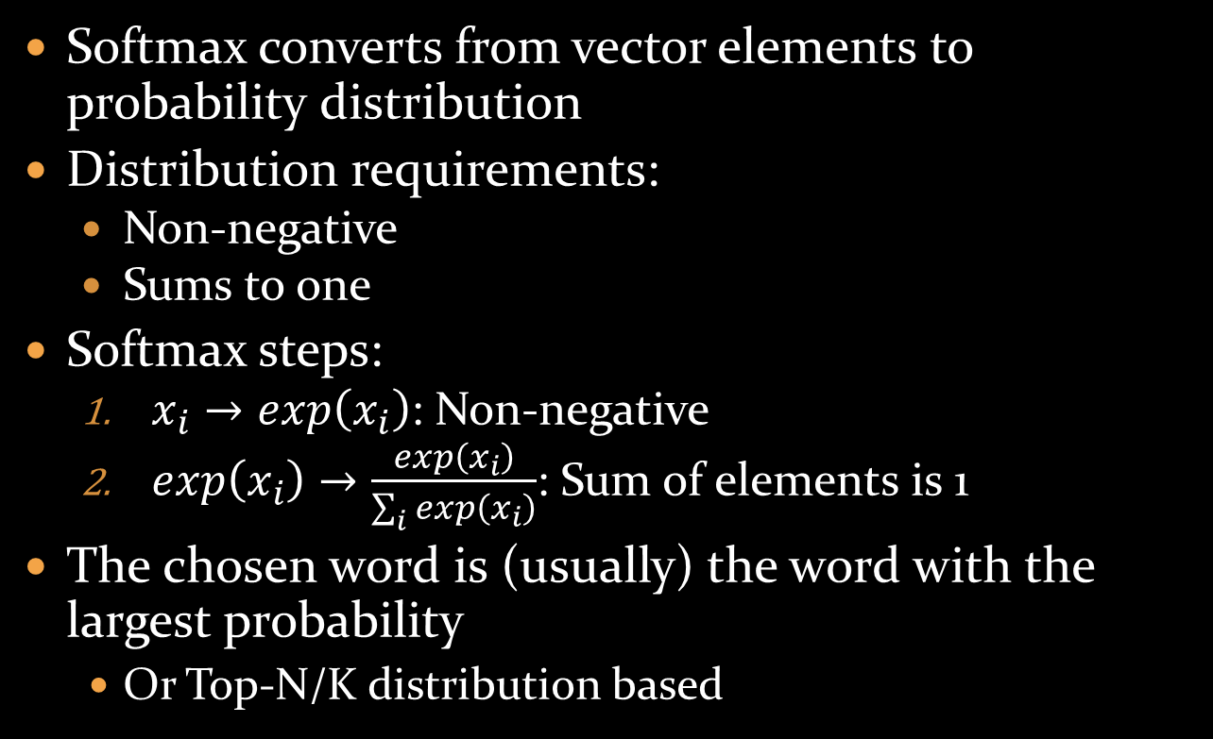
Softmax
Softmax converts from vector elements to probability distribution
Distribution requirements:
Non-negative
Sums to one
Softmax steps:
$x_{i}→exp\left(x_{i}\right)$: Non-negative
$exp\left(x_{i}\right)→\frac{exp\left(x_{i}\right)}{\sum_{i}{exp\left(x_{i}\right)}}$: Sum of elements is 1
The chosen word is (usually) the word with the largest probability
Or Top-N/K distribution based

Slide 19
Positional Embeddings
Due to the parallelization, there is no information about the position of the tokens
A PE (Positional Embedding) is defined and summed to the input embeddings
Desired characteristics:
Unique for each position
Deterministic
Distance between two positions is not affected by position or sentence length
Generalize well to longer sentences than the train set

Slide 20
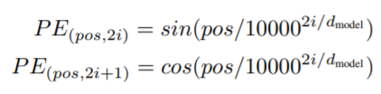
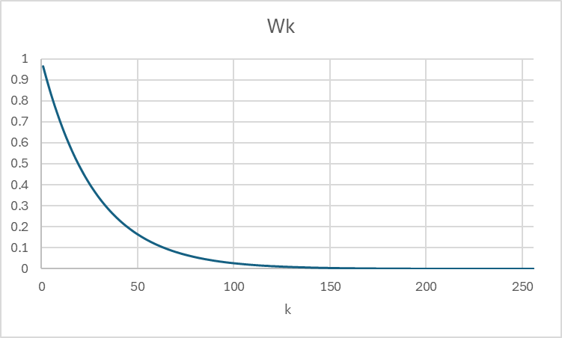

Positional Embeddings
PE:
Or:
${PE}_{\left(2i\right)}=\left\{\begin{matrix}sin\left(w_{k}∙pos\right)⁡ & if i=2k \\ cos\left(w_{k}∙pos\right)⁡ & if i=2k+1\end{matrix}\right.$
$w_{k}=\frac{1}{{10,000}^{{2k}/{d_{model}}}}$
${PE}_{pos}=\left[\begin{matrix}\begin{matrix}\begin{matrix}sin\left(w_{1}∙pos\right) \\ cos\left(w_{1}∙pos\right) \\ sin\left(w_{2}∙pos\right)\end{matrix} \\ cos\left(w_{2}∙pos\right) \\ ⋮\end{matrix} \\ sin\left(w_{d/2}∙pos\right) \\ cos\left(w_{d/2}∙pos\right)\end{matrix}\right]$

Slide 21
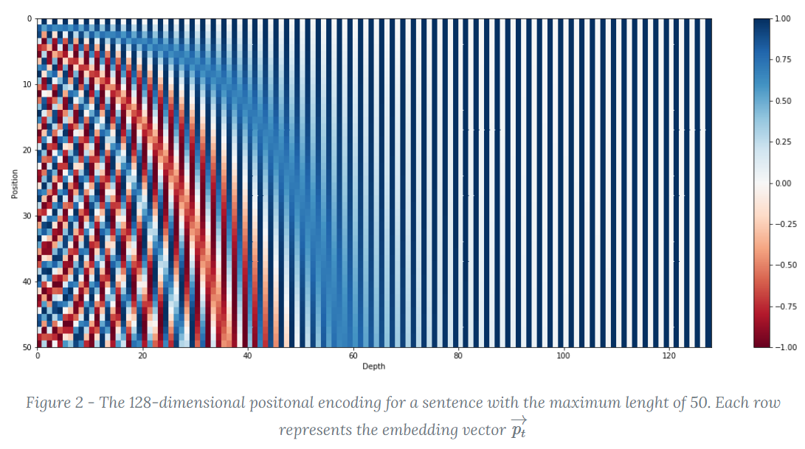
Positional Embeddings: Example
PE:

Slide 22
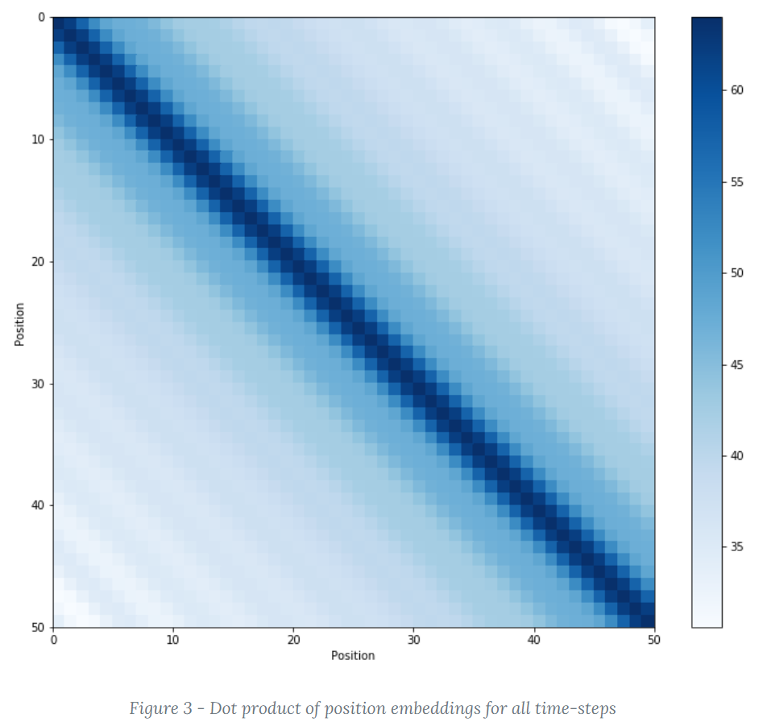
Positional Embeddings: Relative Distance
PE:

Slide 23
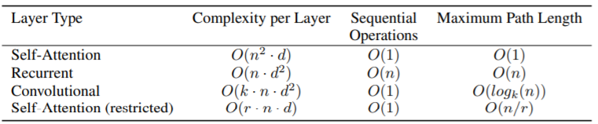
Why Self-Attention?
Sequential steps are O(1), unlike RNNs
Complexity for long sequences is small, compared to RNNs and CNNs
Words are inter-connected, even long-distance words
SA might be restricted to an r-size neighborhood around the token

Slide 24
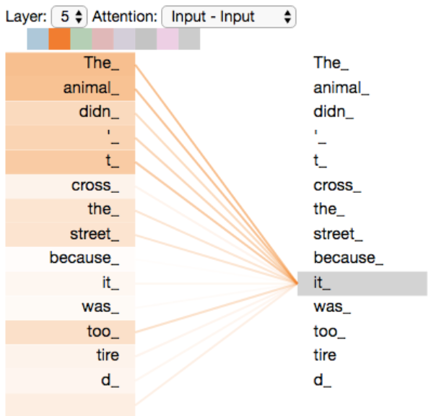
Why Self-Attention?
Sequential steps are O(1), unlike RNNs
Complexity for long sequences is small, compared to RNNs and CNNs
Words are inter-connected, even long-distance words
SA might be restricted to an r-size neighborhood around the token
Self-attention can assist in explainability

Slide 25

Experiments: Data and Configuration
WMT 2014 EN-GE translation (4.5M sentence pairs, 37k tokens BPE)
WMT 2014 EN-FR translation (36M sentence pairs, 32k tokens WordPiece)
Batches of ~25k input tokens and ~25k output tokens
Regularization:
Dropout with prob = 0.1 on each sub-layer output (before the add & norm) and on the sum of embeddings and positional encoding
Label smoothing:
$0→\frac{ε}{K}; ε=0.1$
$1→1−\frac{ε\left(K−1\right)}{K}; ε=0.1$
This hurts perplexity because the model learns to be unsure, but improves accuracy and BLEU
Train time: 12 hours (for d=512) or 3.5 days (for d=1024)
(GPT4 was trained for few months over ~20K GPUs…)

Slide 26
Experiments: Results
EN-GE: BLEU = 28.4, +2 over SOTA (CNN Ensemble, as of May 2017)
2 points improvement is, roughly, 2 more correct words over 100 words
EN-FR: BLEU = 41, -0.3 vs. SOTA (CNN Ensemble)
But training is much faster, 30% of the SOTA model

Slide 27
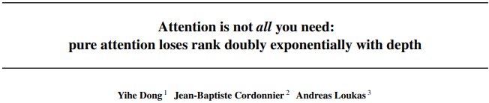
July 2021, 135 313 381 citations

Slide 28
Attention is NOT all you need
When using only Self-attention links, the embeddings are converging to the same value → there is no learning
The main advantage of Transformers are the skip-links (and the FFs, to some extent)
The power of the Transformer comes from an ensemble of short paths

